Slide 1
08 | Tools that make changes
Jeffrey Snover | Distinguished Engineer & Lead Architect
Jason Helmick | Senior Technologist, Concentrated Technology

Slide 2
Module Overview
Tools that need –confirm and –whatif
Impact Level
Using ShouldProcess
A better example

Slide 3
-Confirm and -Whatif
These parameters should be supported for any commands that changes the system state in any way.
If you’re writing an advanced function, there’s no need to hand code these parameters.
[CmdletBinding(SupportShouldProcess=$True,ConfirmImpact=“High”)]
Ctrl-J for the template

Slide 4
Impact Level
Values for Impact Level are Low, Medium and High
$WhatIfPreference is set to $False by default. If you change is to $True, then all commands that support –Whatif will run as if whatif has been specified.
$ConfirmPreference is set to High by default. If the command impact level is equal to or higher than the preference, then –Confirm is automatically added

Slide 5
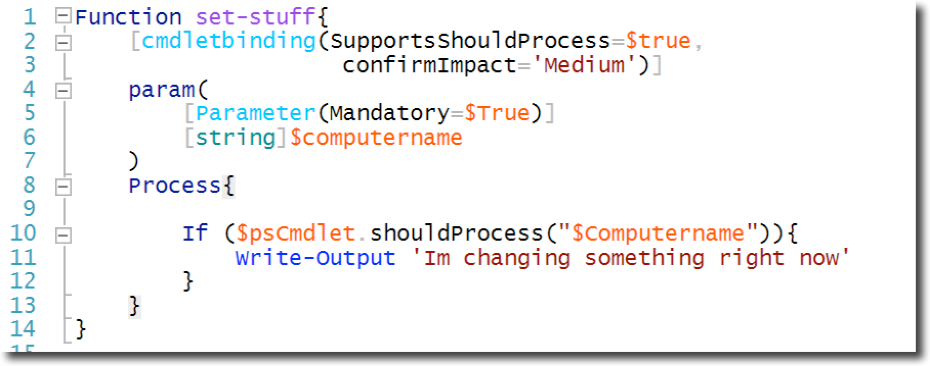
Using ShouldProcess

Slide 6
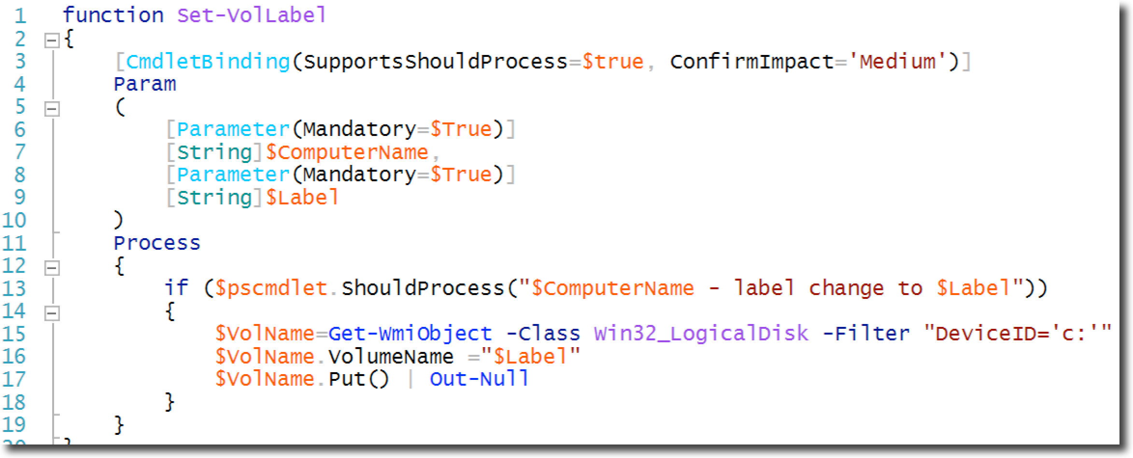
A better example

Slide 7
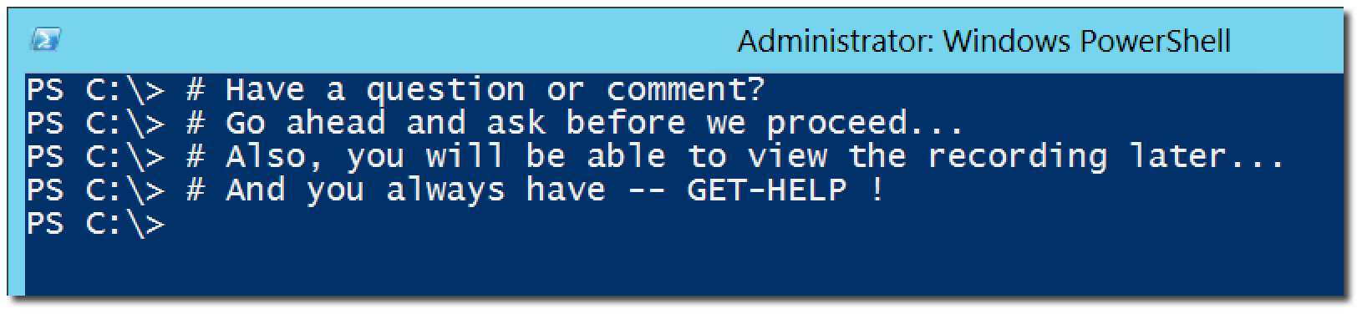
Questions or comments?

